Slide 1
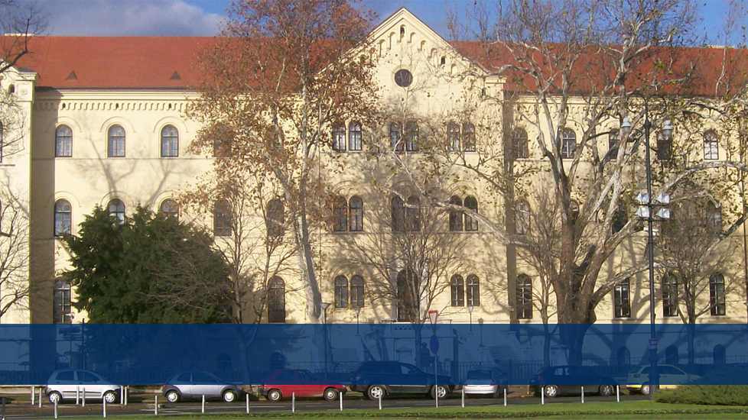


Partner Institution Report UZG
Marko Miliša, December 9, 2022
@ International Univesity of Travnik

Slide 2
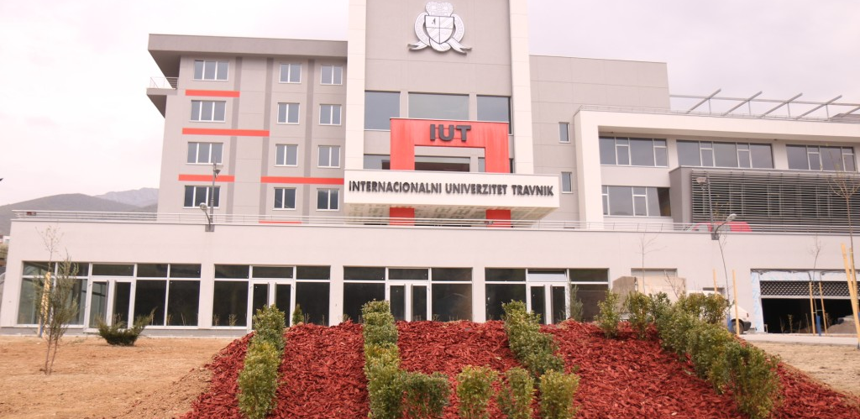
Pre-project activities colaborating with lead partners from Serbia in forming a framework consortium
Visiting and negotiating with perspective users among whom are our todays gratious hosts
Partner Institution Report UZG

Slide 3
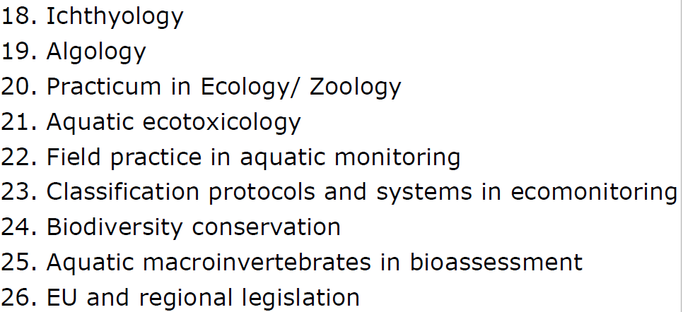
Pre-project activities
Trying to be asistive to our project (leaders) in the setup dozen plus authors invited and accepted work
Partner Institution Report UZG

Slide 4
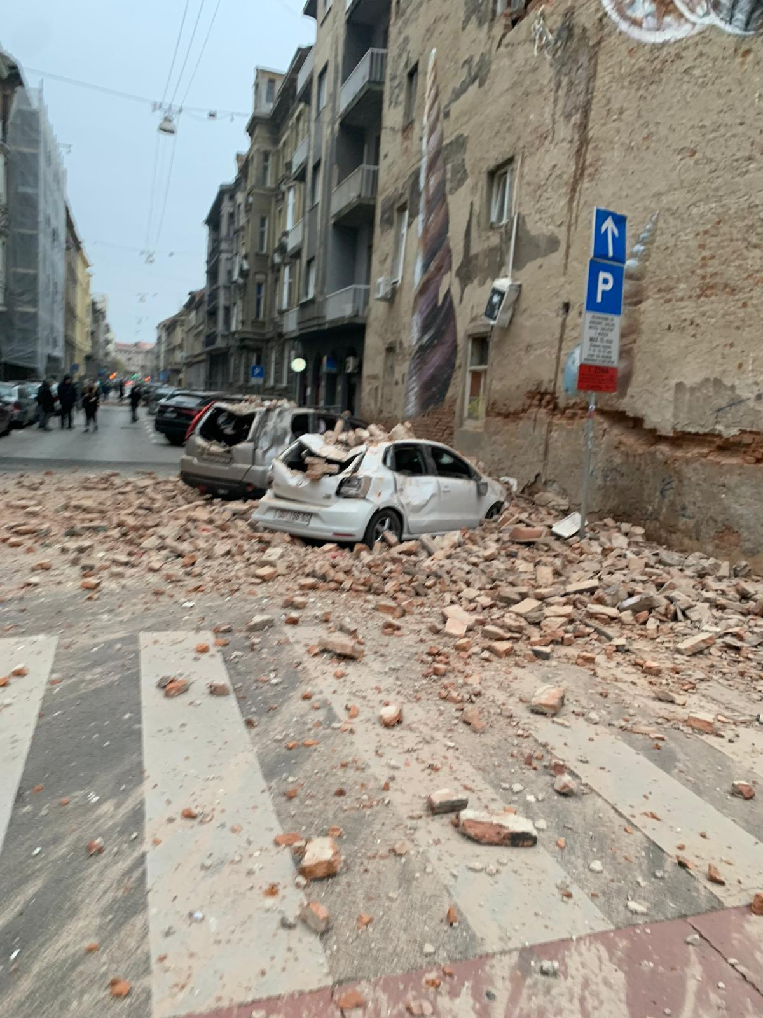
True project activities
Trying to be asistive to our project (leaders) in the setup dozen plus authors invited and accepted work
BUT
Partner Institution Report UZG

Slide 5
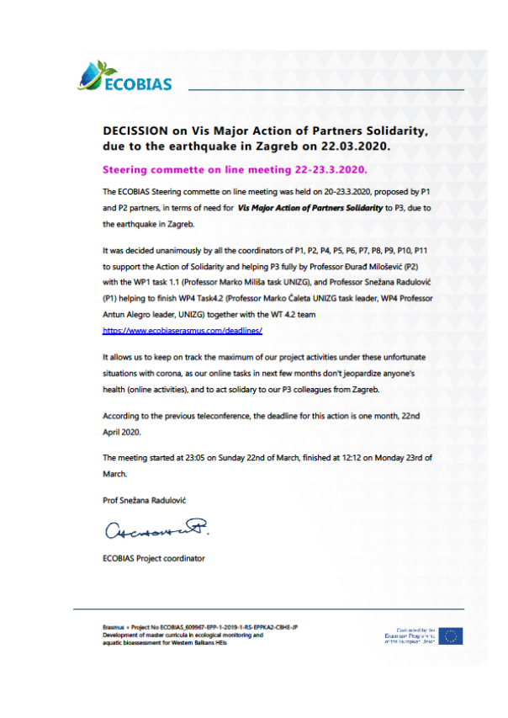

True project activities
Trying to be asistive to our project (leaders) in the setup
Thanks to all of you
Partner Institution Report UZG

Slide 6
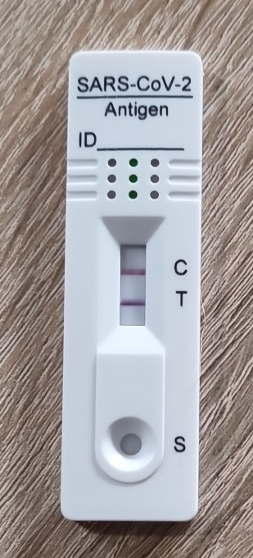
True project activities
All teaching done
Several reteaching
In spite of…
Partner Institution Report UZG

Slide 7
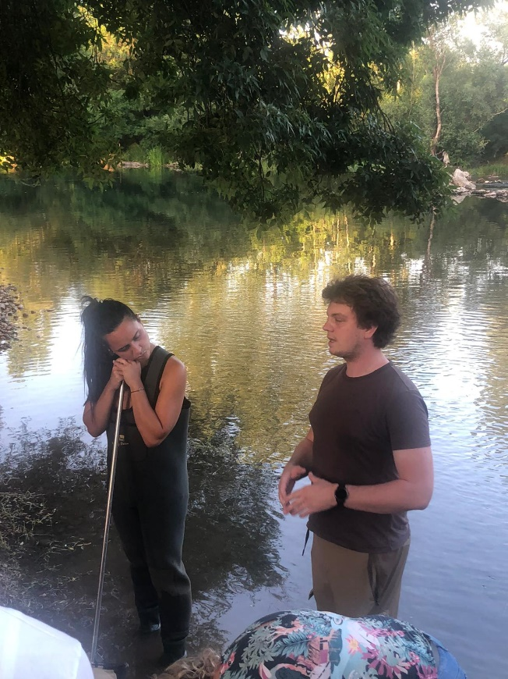
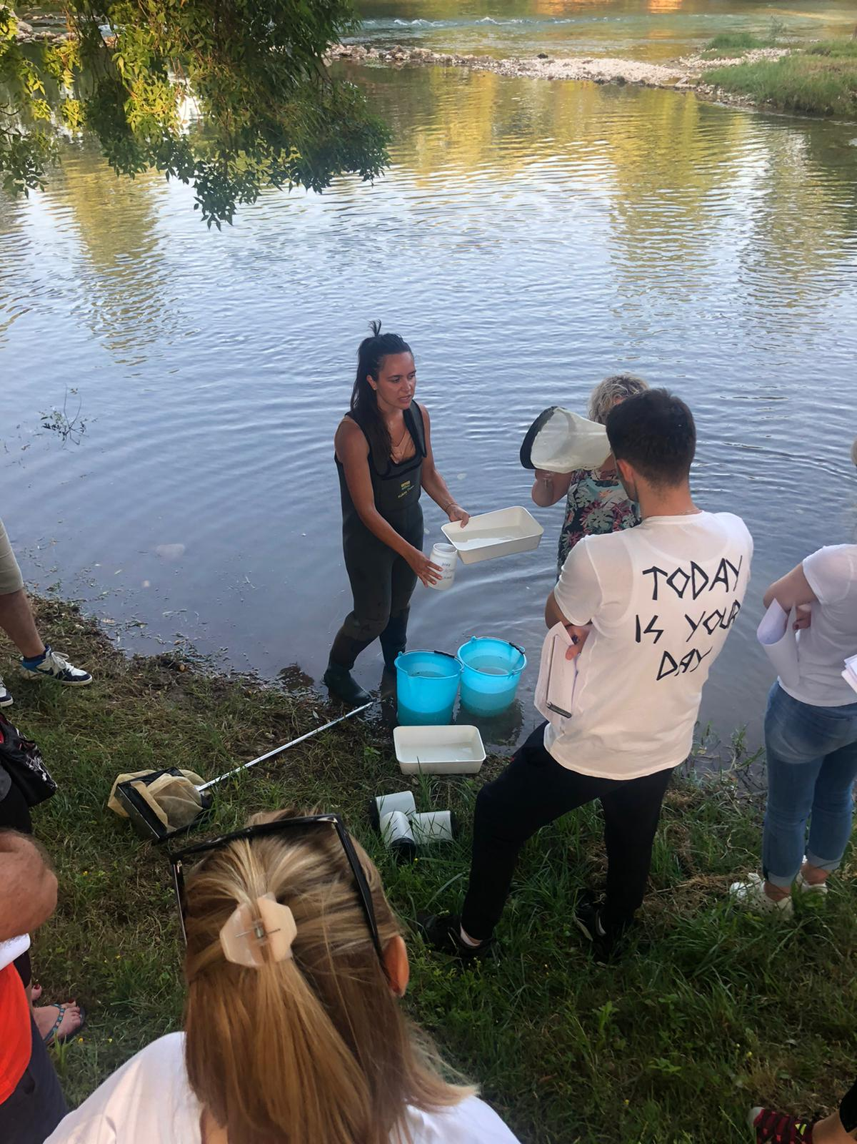
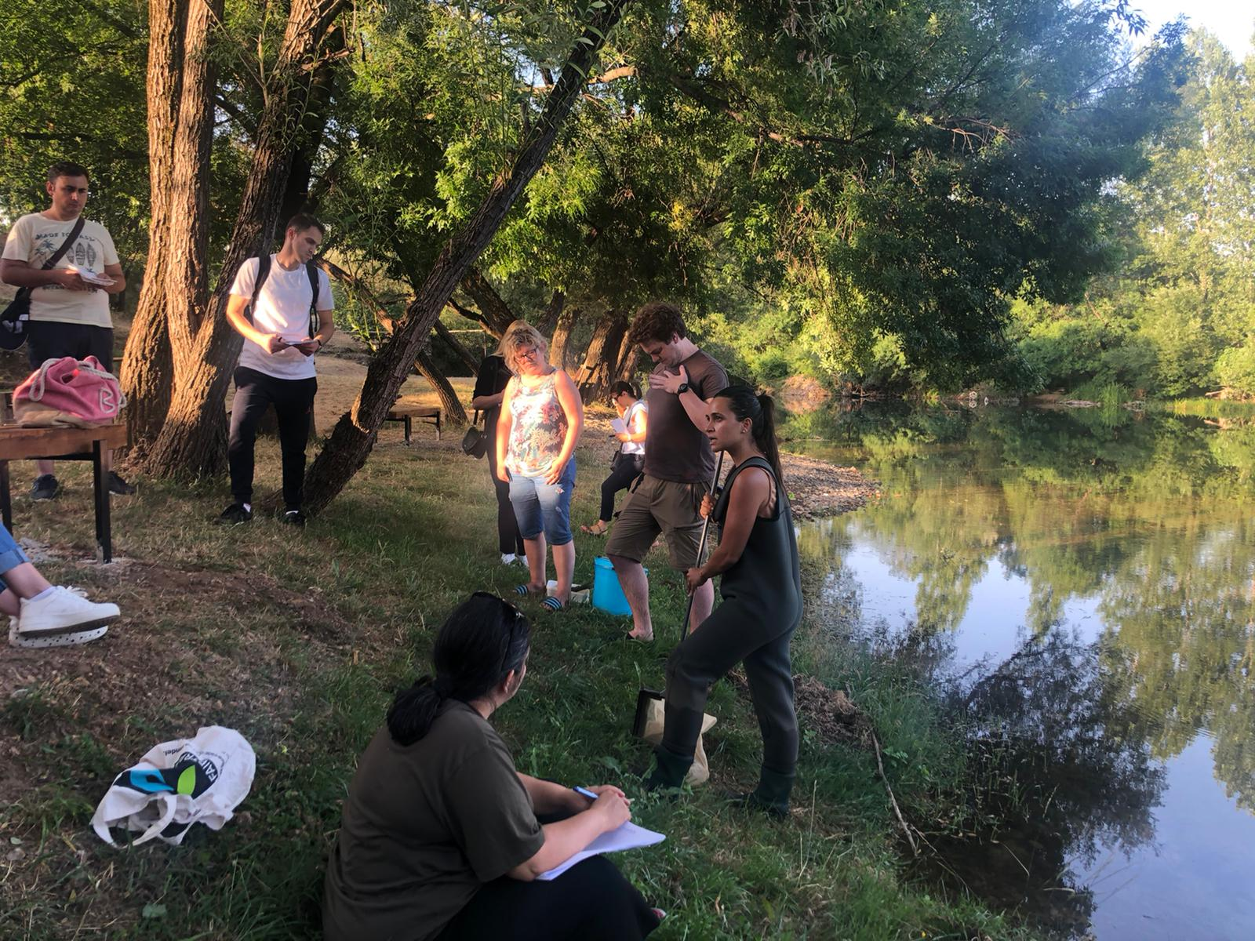
True project activities
All meetings attended one way or other … some … sadly too few organized
Partner Institution Report UZG

Slide 8
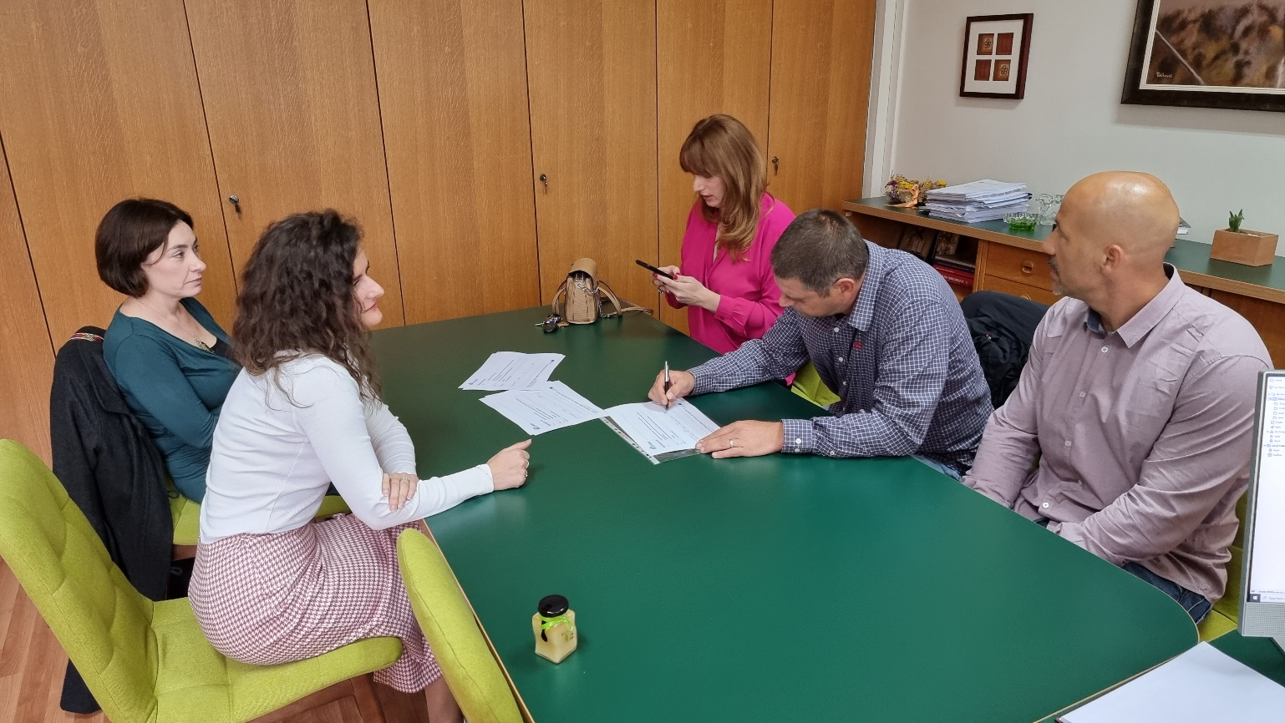
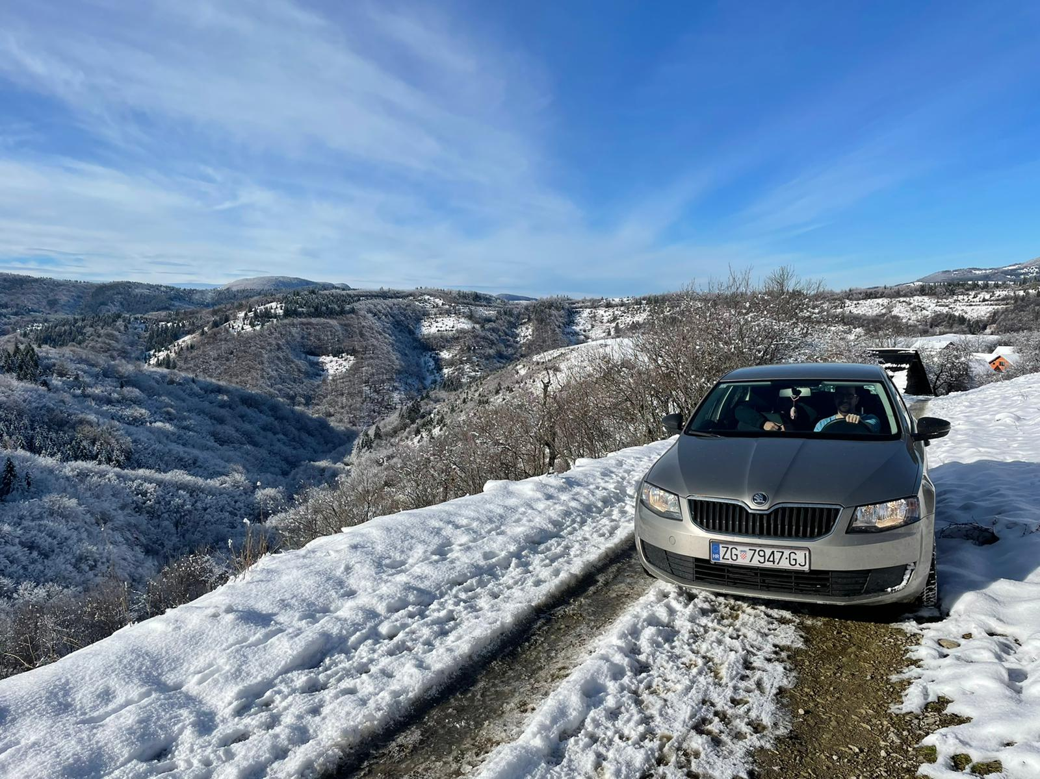
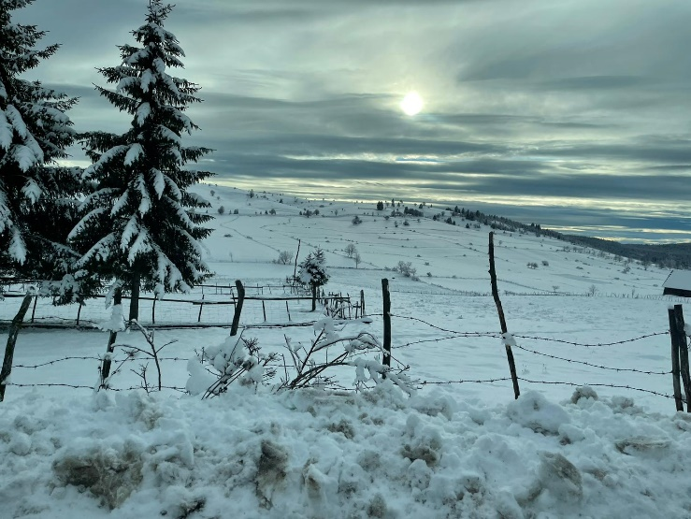
True project activities
All meetings attended one way or other … some … sadly too few organized several times stuck ….
Partner Institution Report UZG

Slide 9
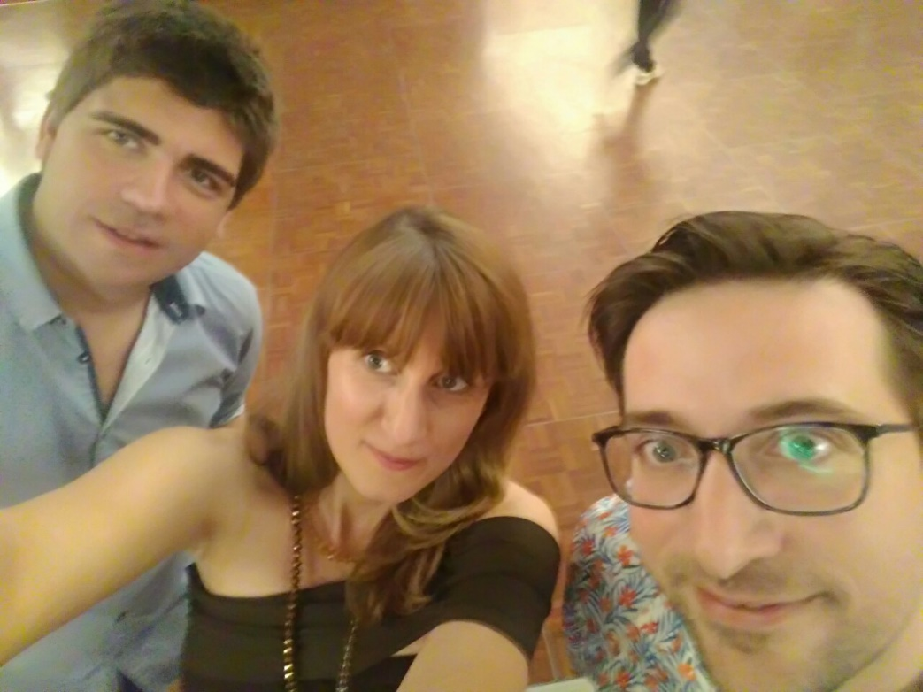
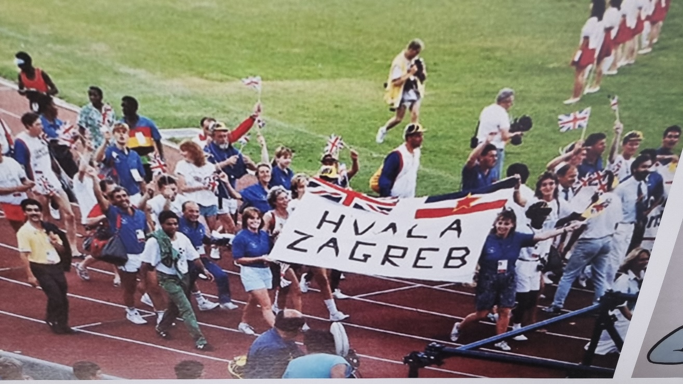
True project activities
All meetings attended one way or other … some … sadly too few organized several times stuck ….
Always came on top
KAŽE
Partner Institution Report UZG

