Slide 1

Development of master curricula in ecological monitoring and aquatic bioassessment for Western Balkans HEIs / ECOBIAS
Prof. dr LJUBICA VASILJEVIĆ,
December 2022
TRAVNIK
FINAL CONFERENCE
9-10 December, 2022

Slide 2
WP 1 Preparation
1.2. Analysis of PC partners Knowledge/Skills/Practice in EMAB
  UES participated in the analysis of knowledge, skills and practices in ecological monitoring and bioassessment in one part of Republic of Srpska, in order to select priority subject area for strengthening within the ECOBIAS curricula and LLL trainings.
1.4. Analysis of labor market needs relevant to EMAB in PCs
  Development of a questionnaire for the analysis of the labor market and needs relevant for ecological monitoring and biological assessment of aquatic ecosystems in partner countries.
  Survey on The Institute for Public Health (Regional Center Zvornik) and the Faculty of Technology.

Slide 3
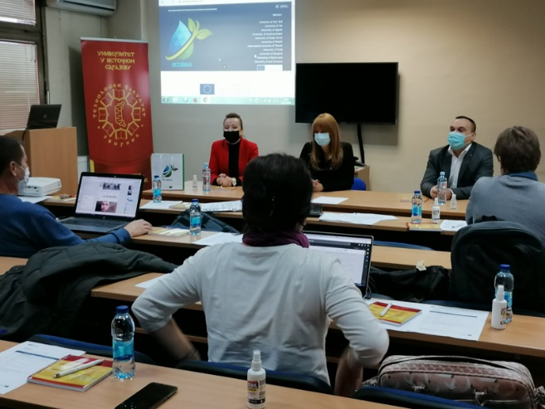
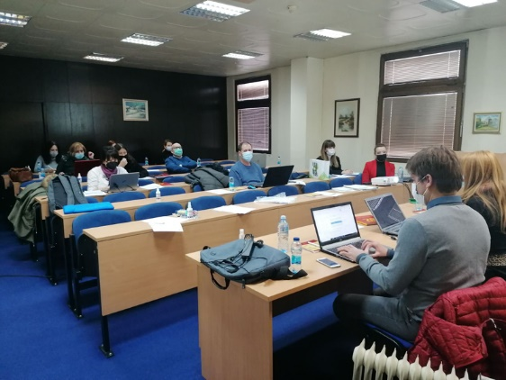
WP 2 Development
Development of master curricula, accreditation/approval, implementation
Development of aims, specific competencies and learning outcomes of master curricula, courses design and syllabus for MSc curricula at UES.
Participation at theme-based training of teaching staff for acquiring new EMAB methods and field techniques (2.4.) for 9 courses for UES, organized at University of Novi Sad, University of Banja Luka, University of Mostar, University of Tuzla, and University of East Sarajevo.
UES organized two-day theme-based training of teaching staff for acquiring new EMAB methods and field techniques, held in December 2020 (2.4).

Slide 4
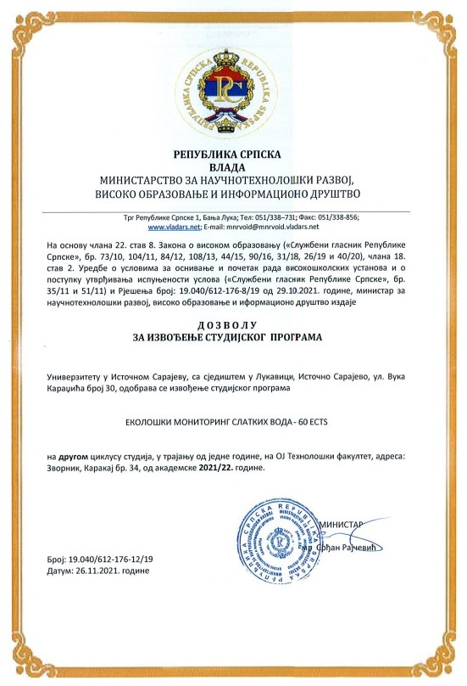
WP 2 Development
Development of master curricula, accreditation/approval, implementation
The University of East Sarajevo prepared the Elaborate on the justification of the implementation of the study program "Environmental Freshwater Monitoring„ for the II cycle of studies, which was adopted by the Scientific Teaching Council at the Faculty of Technology, the Senate of the University of East Sarajevo, and submitted to the competent Ministry together with request for obtaining a permit for the operation of this study program.
On November 26, 2021 the Ministry issued a permit for the work of this study program, which met all the prerequisites for enrolling students. (2.6.)
Developed and implemented „Environmental Freshwater Monitoring„ MSc study program consists of 9 courses
13 students enrolled in at UES:
  9 students enrolled in 21/22 (80% more than planned in project proposal)
  4 students enrolled in 22/23
Teaching staff at UES:
  7 teachers
  6 assistants

Slide 5
WP 2 Development
2.3. Purchasing of literature, software and laboratory equipment, installation and activation
The tender procedure at the UES was conducted separately form other institutions form B&H.
The procedure for purchase of equipment was distributed in five different open calls and published as follows:
  Computing Equipment on April 9, 2021;
  Optics (Laboratory Equipment) on April 20, 2021;
  Sampling Equipment on April 30, 2021;
  Water Equipment on May 26, 2021;
  Chemicals on December 15, 2021.

Slide 6
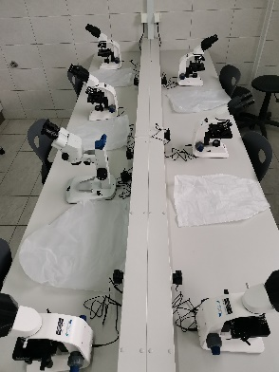
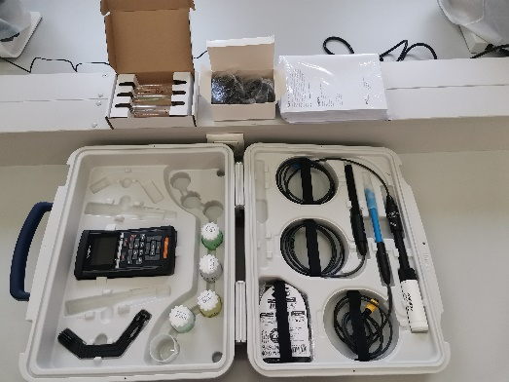
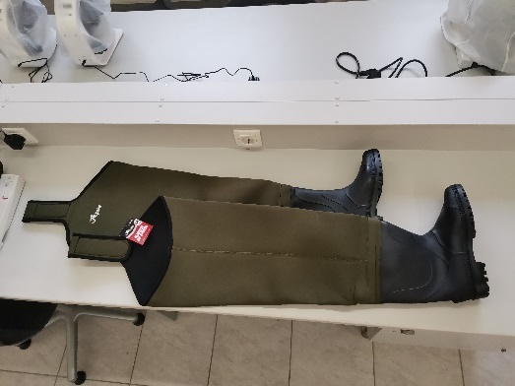
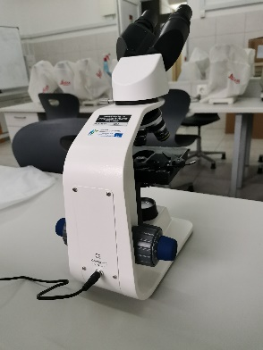
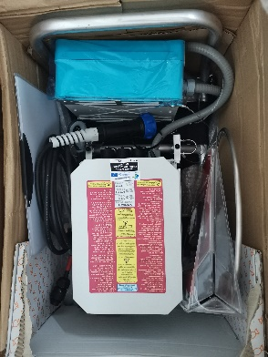
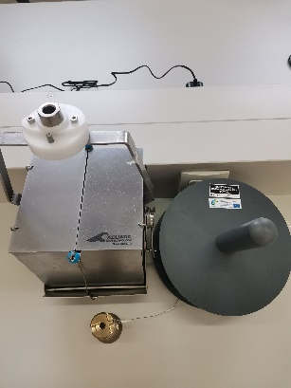
WP 2 Development
2.3. Purchasing of literature, software and laboratory equipment, installation and activation
All procedures were successful and met requested standards. According to the project financial plan, the overall budget planned for the equipment for University of East Sarajevo was 24.400 EUR. After the procedure for the procurement of the equipment the amount of 21.472,7 EUR was spent.
The purchased equipment is located in the laboratory at the Faculty of Technology Zvornik. The laboratory will be used for courses within the “Environmental Freshwater Monitoring” master program, of the ERASMUS+ PROJECT ECOBIAS, but also for others courses that are held at Faculty of Technology Zvornik, master and PhD studies.

Slide 7
WP 4 Quality Plan
UES participated in the process of Quality Assurance of project implementation.
Participation in the development of Quality and Assurance Plan. (4.2.)
Participation in the Quality Assurance Board meetings. (4.3.)

Slide 8
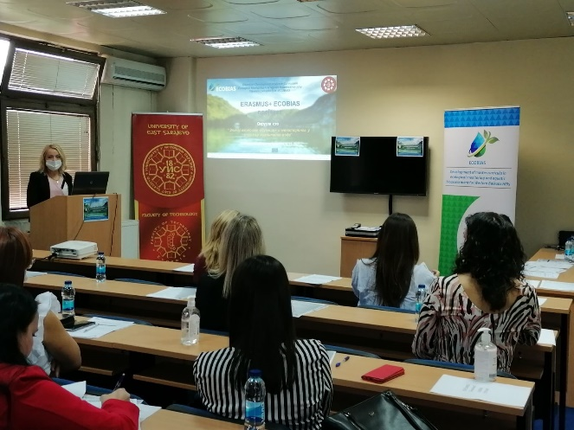
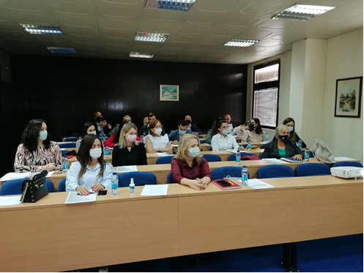
WP 5 Dissemination & Exploitation
Round tables with stakeholders (5.5.):
On October 6, 2021, at the Faculty of Technology in Zvornik, organized a round table under the title „The importance of environmental education and monitoring in the preservation of water quality“. Stakeholders from various areas of the economy were present, among others from the companies Alumina and Zeohem, the Institute of Public Health, the City Administration of the City of Zvornik, the Regional Landfill in Zvornik, the National Park "Drina", the Municipality of Milići and Srebrenica, the Geological Institute of the Republic of Srpska and others.
On May 25, 2022, at the Faculty of Technology in Zvornik, second round table was held under the title „Monitoring of water quality, environmental protection and environmental education“. The second round table hosted interested participants from the public sector in the area. Stakeholders from various areas of the economy were present, among others from the companies Alumina and Zeohem, the City Administration of the City of Zvornik, the Regional Landfill in Zvornik, the Municipality of Srebrenica, the Geological Institute of the Republic of Srpska, the laboratory "Euroinspekt" and others.

Slide 9
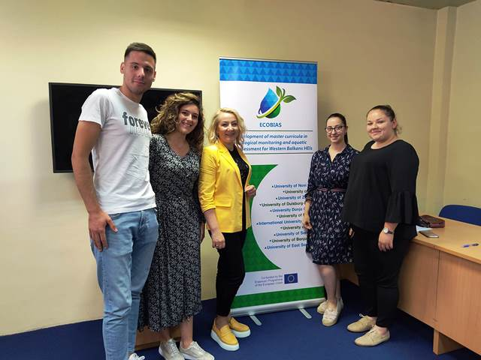
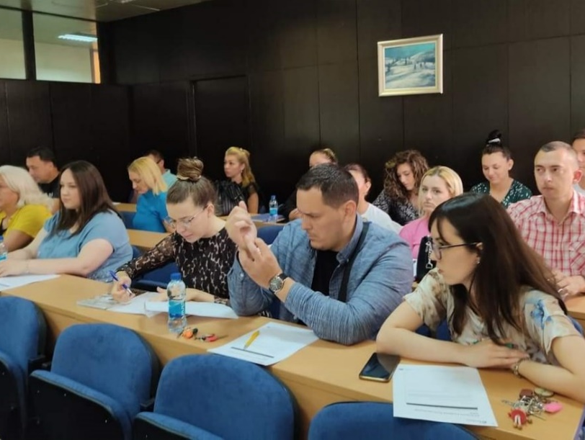
WP 5 Dissemination & Exploitation
Participation in the preparation of project dissemination plan, designing and publishing promo material, and organization of dissemination events.
UES participated at the Workshop and Summer School in DNA Metabarcoding at University of Tuzla held from 5 to 8 September, 2022.
UES organized two open days at the Faculty of Technology Zvornik for the purpose of promoting new master program. One was held on October 6, 2021, and second on May 25, 2022. (5.6)

Slide 10
WP 4 Management
UES participated at all SC and PM meetings.
Implementation of activities within the timeframe determine by the management board.
Regular interim reporting.

Slide 11
Thank you for your attention!
Prof. dr Ljubica Vasiljević
Faculty of Technology Zvornik, University of East Sarajevo

